Slide 1
Annual Provider Meeting UF North Central Early Steps Child Outcome Summary
Notes:
Welcome

Slide 2
COS Process-Exit COS Decision Tree
Was there at least 6 months of services performed?
Did the child enter the program after December 1, 2020 and an entry COS was completed?
Complete an Exit COS and submit with discharge summary to child’s Service Coordinator
Complete the assessment the child entered with (i.e. BDI, DAYC) and submit with discharge summary to child’s Service Coordinator
Did the child enter the program after December 1, 2020 and an entry COS was completed?
Determining Length of Services
Determining Date of Entry
Determining need for Exit COS
Complete an Exit COS and submit with the discharge summary to the child’s Service Coordinator
No Exit assessment is needing to be performed. Submit the discharge summary to the child’s Service Coordinator.
Families to consider for exit evaluations include:
1. A child who met their outcomes and caregiver has no further concerns
2. Caregiver has withdrawn from Early Steps services after an IFSP is in place
3. A child is determined no longer eligible at redetermination (i.e. Period and Annual Reviews) and family has no further concerns
4. A child is turning 3 years of age and is aging out of Early Steps
Yes
No
Yes
No
Yes
No
Please send all completed COS forms to Sharon via MoveIt
and CC the child’s Service Coordinator

Slide 3
COS Process-Completion and Billing
Redefining “Exit”:
Exit ≠ Tool
Think of an “Exit” not as an assessment or tool that needs to be completed, but as a process you complete with the family to discuss progress, change, and create a sense of closure with the family.

Slide 4
COS Process-Completion and Billing
Guidelines for completing an Exit COS:
Exit COS must be completed within 30 days of the child’s 3rd birthday or within 30 days of discharge
Attempts must be made to include the family during the exit COS discussion. If you are unable to contact the family, then the exit COS may be completed with other team members familiar with the family (i.e. Service Coordinator, other providers, consultants, etc.) within 30 days of discharge
You may complete the exit COS during an EI session or during a separate time billed as an “Exit” (maximum 1 hour will be allotted to the PSP)
Send completed Exit COS form to Sharon, CCing the child’s Service Coordinator via MoveIT

Slide 5
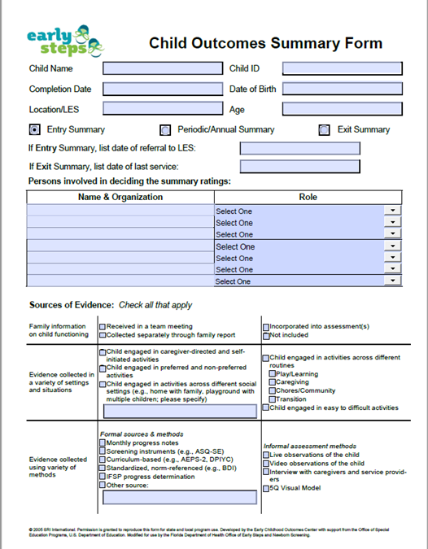
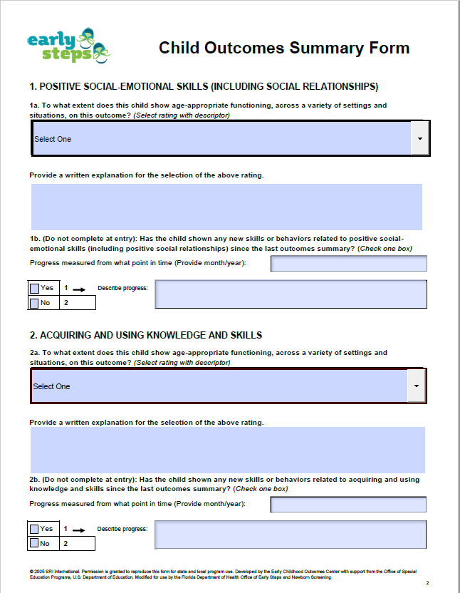
COS Process-Form
Please open and save the form through the free, basic Adobe Software and not a web browser

Slide 6
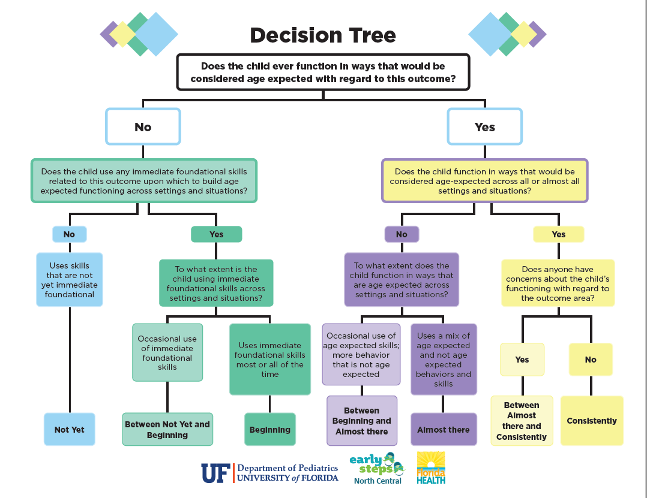
COS Process-Resources

Slide 7
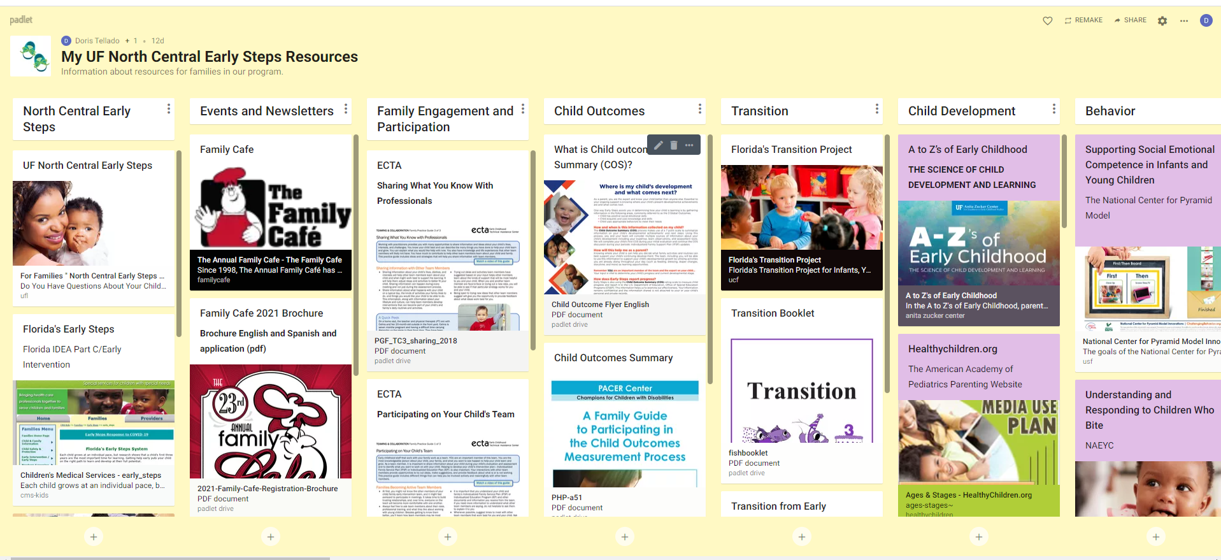
COS Process-Resources
English Padlet
https://padlet.com/dtellado/nihblr6k8o03x2tw
Spanish Padlet (under construction)
https://padlet.com/dtellado/wanl4ami0zbynosa

Slide 8
COS Process- Questions?

